Slide 1
Week 2
Variables and constants
Primitive and Reference Types
Casting
Numbers, Strings, and Arrays
Read Input

Slide 2

Functions

Slide 3
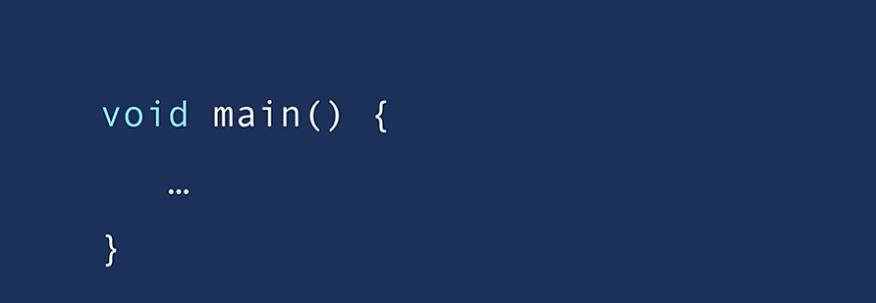
Entry point to the program

Slide 4
Class A container of related functions To organize our code Every Java program should have at least one class that contains the main function We refer to functions inside classes as Methods All Classes and Methods have an Access Modifier

Slide 5
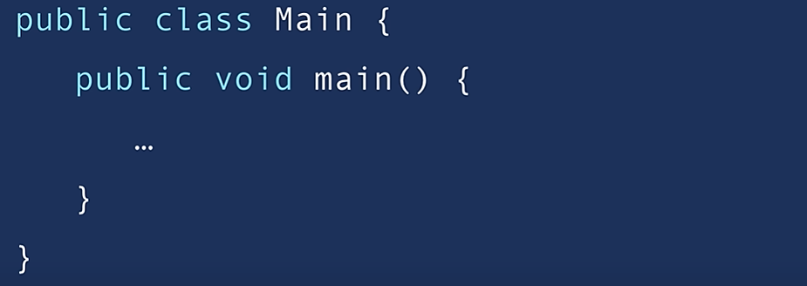
Access Modifier A special keyword that determines if other classes and methods in this program can access these classes and methods like Public and Private

Slide 6

Classes Methods
Naming Conventions

Slide 7
Lets Compile and run a basic Java Program

Slide 8
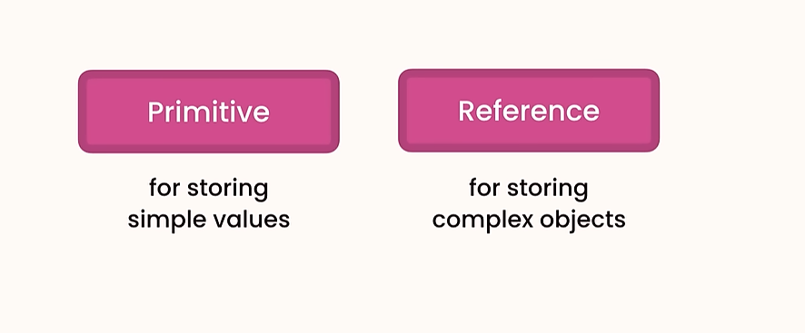

Slide 9
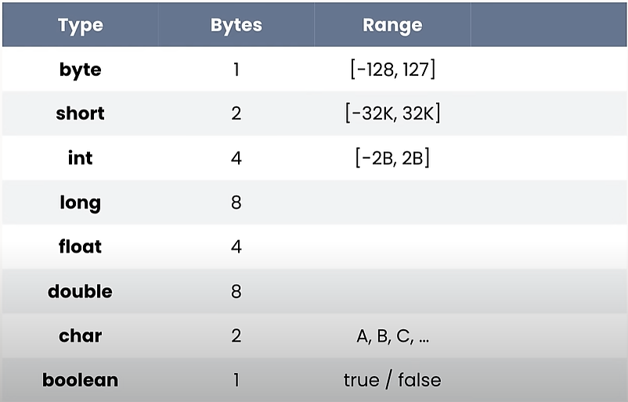
Primitive Types

Slide 10
As a best practice Always use meaningful and descriptive names for your variables

Slide 11
We can use underscore to separate large numbers to make them easies to understand, just like using commas in Math 123,456,789

Slide 12
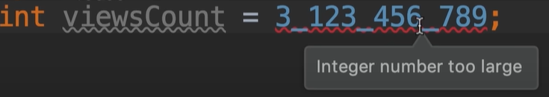
We can use a small L but it looks like the number 1 so it’s better to use capital

Slide 13
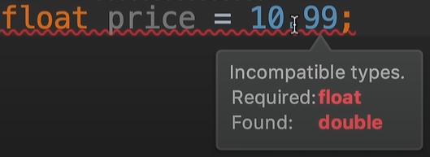

Same for float and double

Slide 14
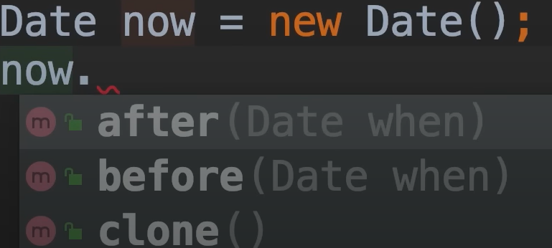
Difference Between Primitive & Reference Types
For Reference types we need to use the new operator to allocate memory for variables (Released by JRE)
Reference types have members while Primitive types do not
An object is an instance of a
class now this object or this
class have members that we
can access using the dot operator

Slide 15

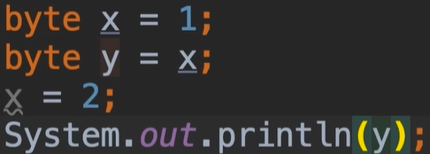

Slide 16
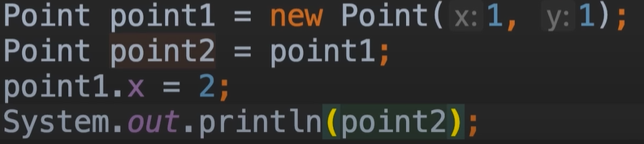

Slide 17
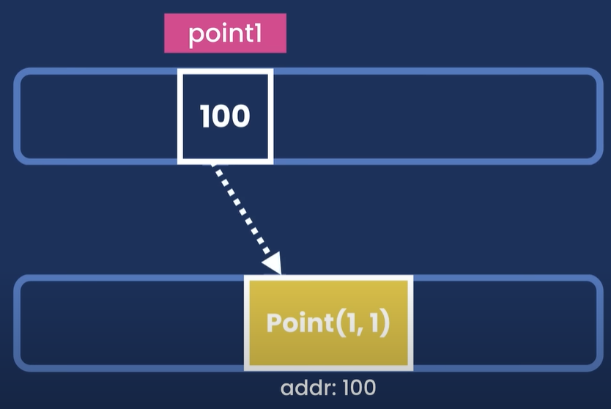

Slide 18
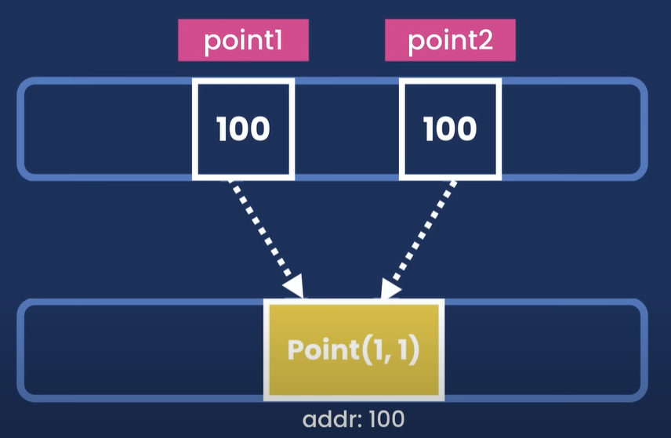

Slide 19
Reference types are copied by the references whereas primitive types are copied by their value and these values are completely independent of each other

Slide 20
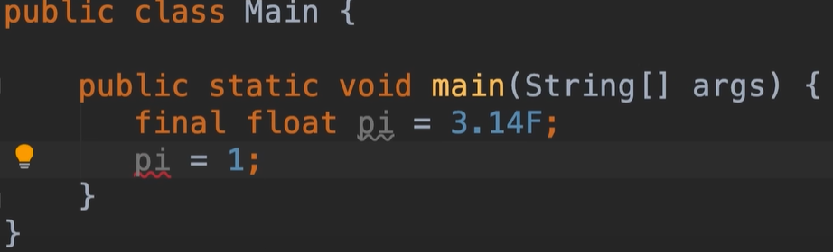
Constants

Slide 21
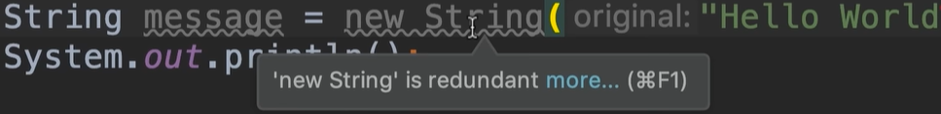
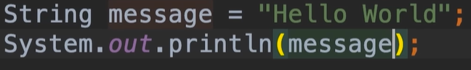
Strings
Strings look like a primitive type because we are not using the new operator but this is just a shorthand to initialize a string variable
Strings are reference types in Java but because we use them often there is a short way to create them

Slide 22
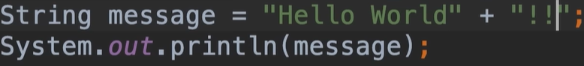
Strings
We can concatenate or joining a string with another one using the plus operator

Slide 23
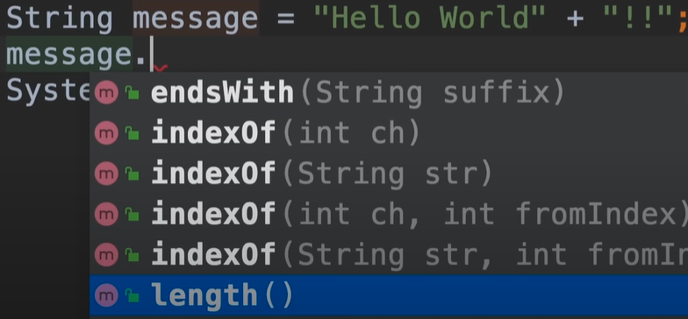
Strings
Because string is a class it has members that we can access using the dot operator

Slide 24
Difference between parameters and arguments: Parameters are the holes that we define in our methods, arguments are the actual values that we pass to these methods

Slide 25
In Java strings are immutable we cannot mutate them we cannot change them so any methods that modify a string will always return a new string object Lets try the methods replace, toUpperCase, toLowerCase, and trim

Slide 26
To include Double quotations in our strings, we use back slash → \” To include a back slash in our strings, we use back slash → \\ \n is added where you want a new line \t is added where you want a tab

Slide 27
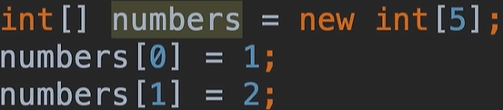
Arrays
We use arrays to store a list of items like a list of numbers or a list of people or a list of messages
Arrays are reference types
We can access individual
items in this array using
an index

Slide 28
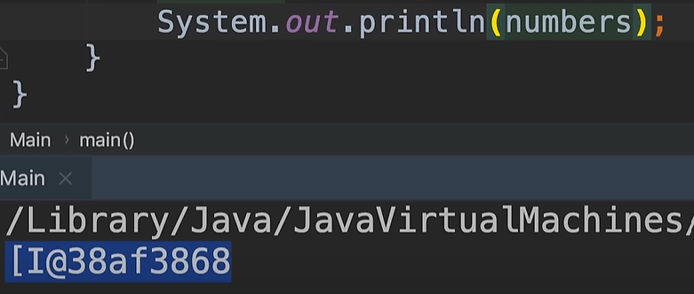
By default when we print an array Java returns the string which is calculated based on the address of this object in memory

Slide 29
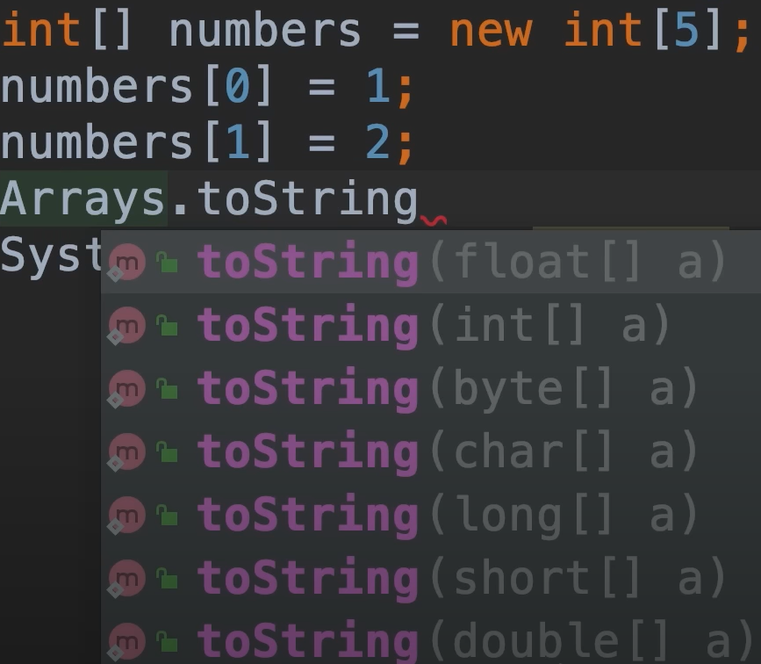

To print the content of the Array we use the method toString() This Method can receive different parameters, which is called Method Overloading

Slide 30
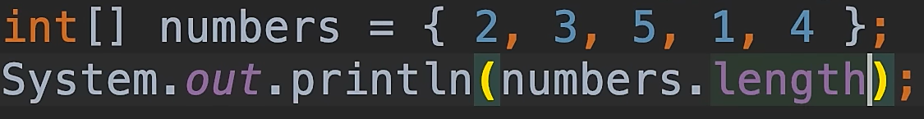
This is an easier way to define arrays when you know the initial values In Java arrays have a fixed size so once we create them we cannot add or remove additional items to them they have a fixed length If you want to be able to add or remove additional items from an array you should use one of the collection classes that we'll talk about later in the course

Slide 31
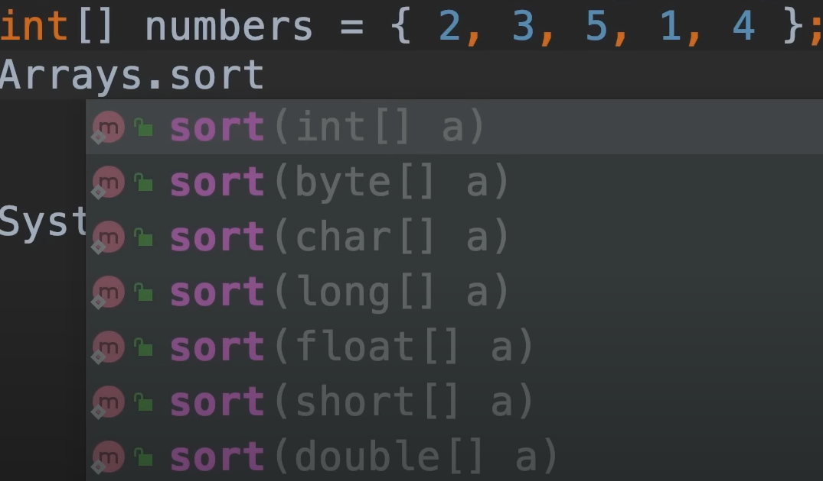
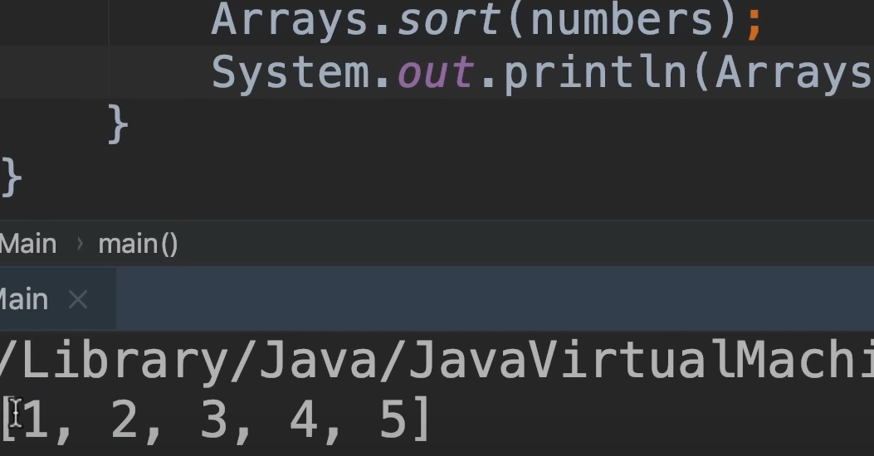
We can sort the Arrays using the sort method in the Array class

Slide 32
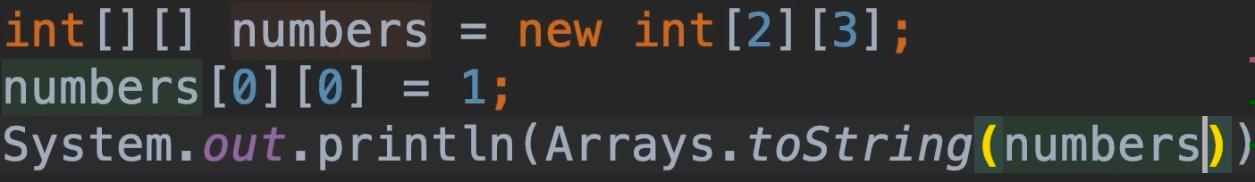
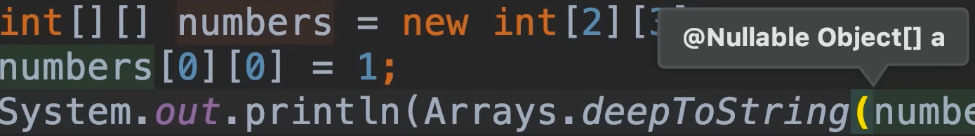
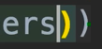
Multi-Dimensional Arrays

Slide 33
Expression: piece of code that produces a value Arithmetic expression: 5+4 Arithmetic Operators: +, -, *, /, %, ++, --, +=, -=, *=, /= Operands are the values used: 5 & 4 in the example We can apply these operators (++, --) as postfix or as prefix: x++ or ++x

Slide 34
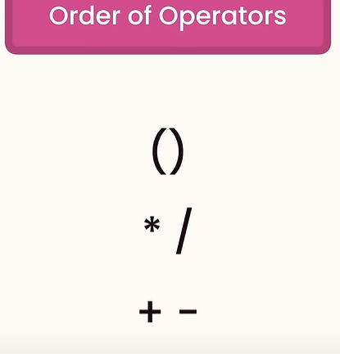

Slide 35
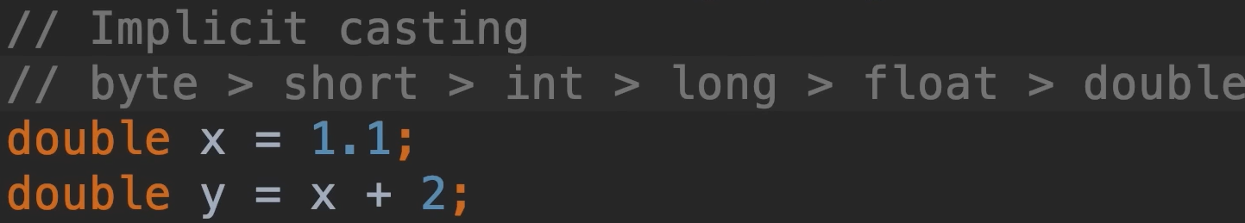
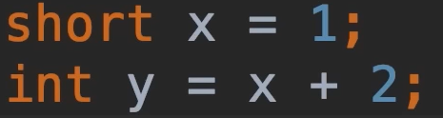
Implicit Casting Implicit casting happens whenever you're not going to lose data

Slide 36
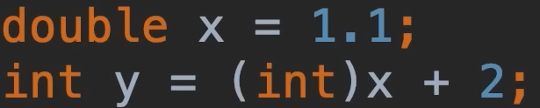
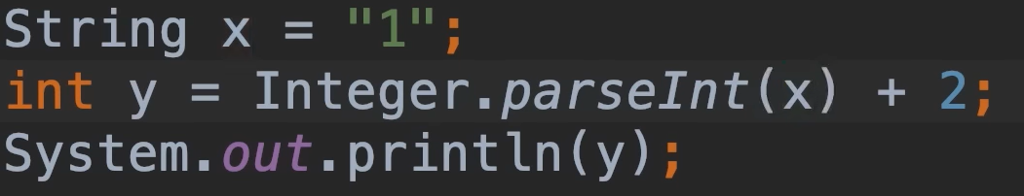
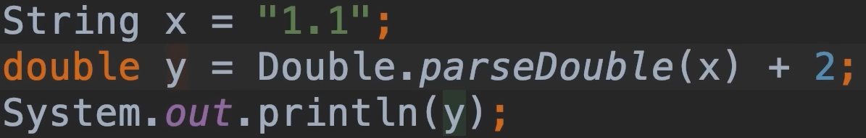
Explicit Casting Can only happen between compatible types All numeric values can be Explicitly Casted to each other But we cannot cast a string to a number To convert String to Numeric type we use the wrapper class for that type

Slide 37
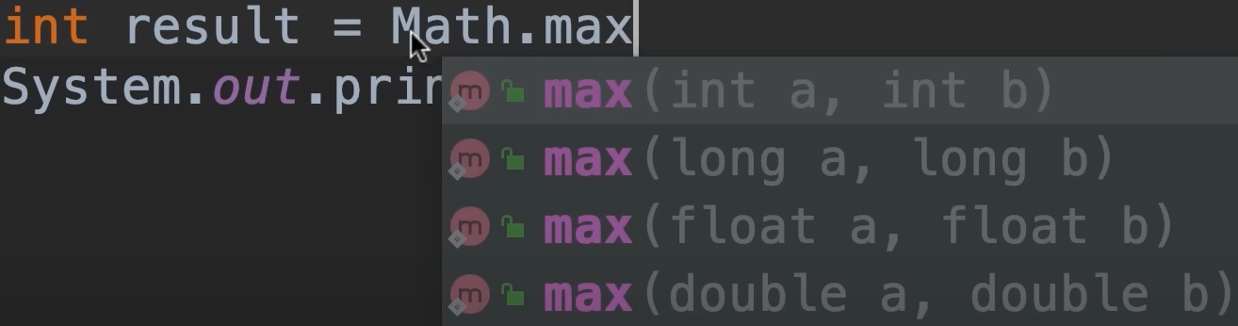
Math Class

Slide 38
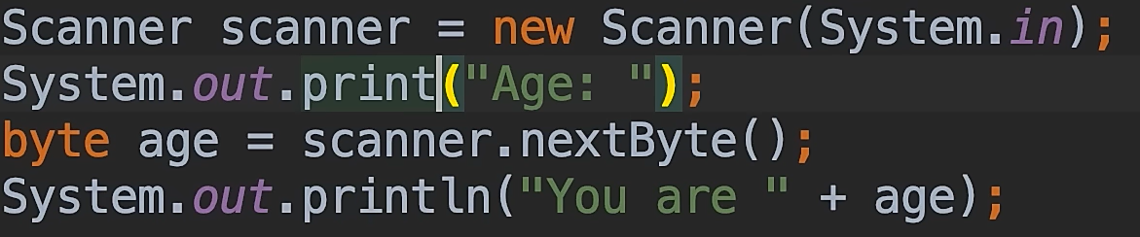
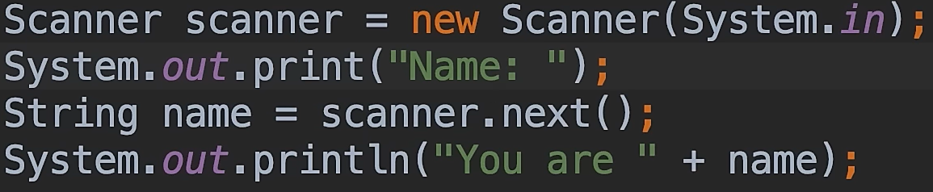
Reading Input

Slide 39


Slide 40
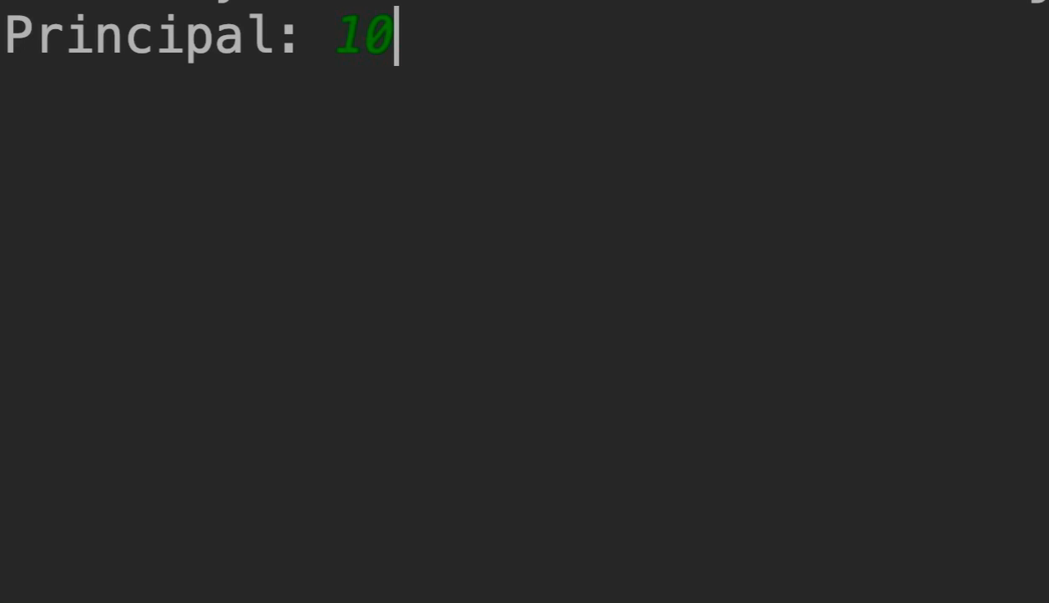
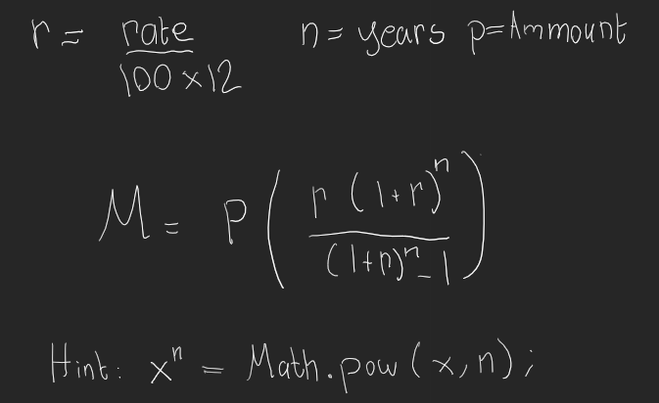
Mortgage Calculator

